Slide 1
Example: What topological features does the following data exhibit?
Problem: Discrete points have trivial topology.

Slide 2
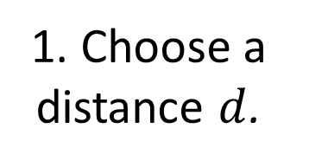

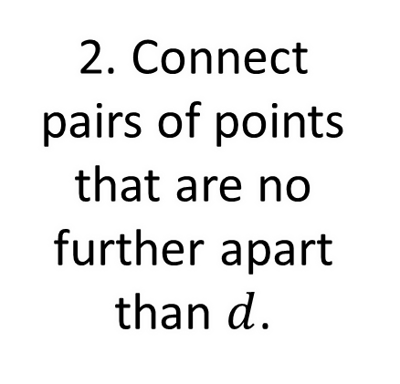
Idea: Connect nearby points.
2. Connect pairs of points that are no further apart than $d$.
1. Choose a distance $d$.
$$d$$
Problem: A graph captures connectivity, but ignores higher-order features, such as holes.

Slide 3
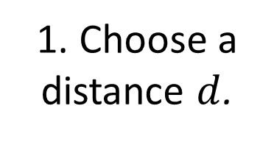

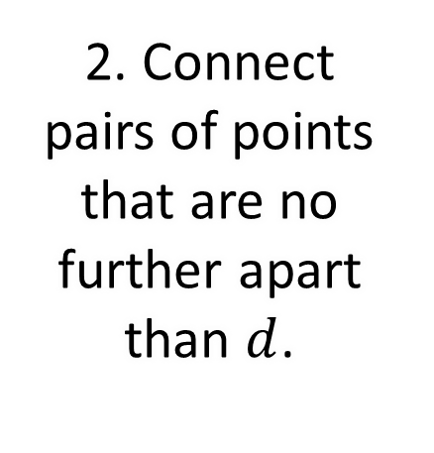
Idea: Connect nearby points, build a simplicial complex.
3. Fill in complete simplices to obtain the Rips complex.
1. Choose a distance $d$.
2. Connect pairs of points that are no further apart than $d$.
4. Homology detects the hole.
$$d$$
Problem: How do we choose distance $d$?

Slide 5
If $d$ is too small…
…then we detect noise.

Slide 7
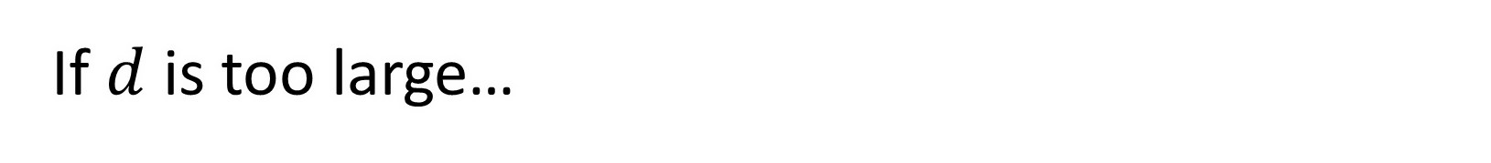
If $d$ is too large…
…then we get a giant simplex (trivial homology).

Slide 8



Problem: How do we choose distance $d$?
How would we find this $d$ without a global picture of the point cloud?
This $d$ looks good.
$$d$$
Idea: Consider all distances $d$.

Slide 9
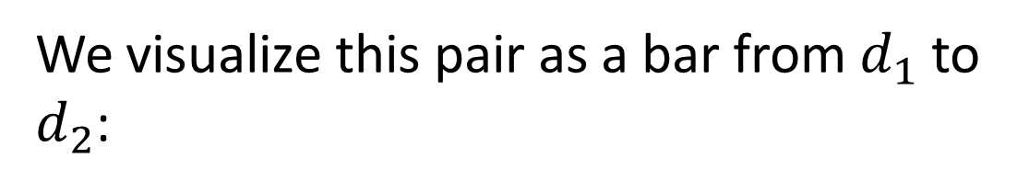


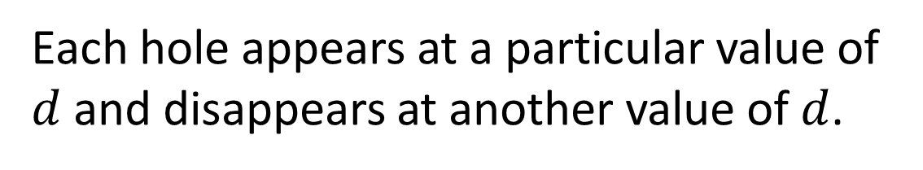
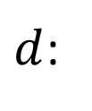



Each hole appears at a particular value of $d$ and disappears at another value of $d$.
$$d_{1}$$
We can represent the persistence of this hole as a pair $\left(d_{1},d_{2}\right)$.
We visualize this pair as a bar from $d_{1}$ to $d_{2}$:
$$d_{2}$$
$d$:
$$d_{1}$$
$$d_{2}$$
A collection of bars is a barcode.

Slide 10






Example:
Record the barcode:
$d$:
$$0$$
$$1$$
$$2$$
$$3$$
$$4$$

Slide 11
Example:
Short bars might represent noise.
Long bars might represent features.
Record the barcode:
$d$:
$$0$$
$$1$$
$$2$$
$$3$$
$$4$$

Slide 12
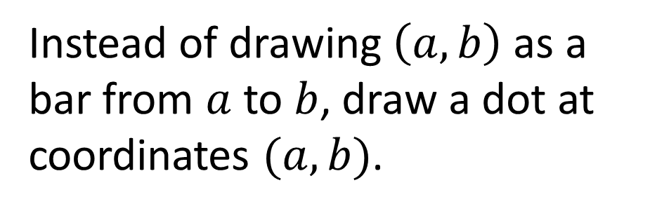
A persistence diagram is an alternate depiction of a barcode.
Instead of drawing $\left(a,b\right)$ as a bar from $a$ to $b$, draw a dot at coordinates $(a,b)$.
The farther a dot is from the diagonal, the more persistent the feature it represents.

Slide 13
Application: Digital Images
High-contrast 3-by-3 pixel patches from grayscale digital images…

Slide 14
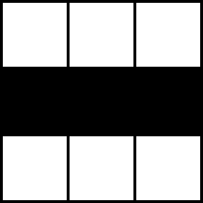
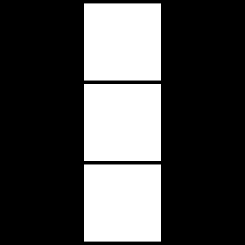
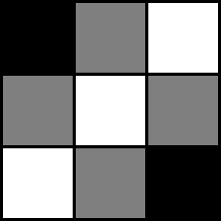
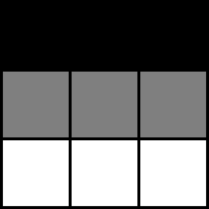
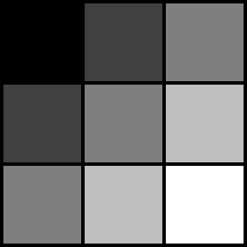
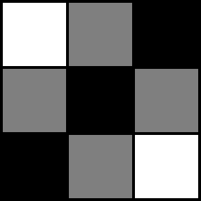
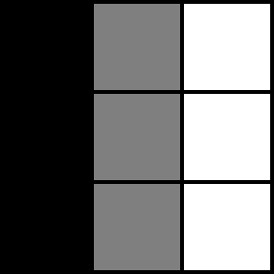
Application: Digital Images
High-contrast 3-by-3 pixel patches from grayscale digital images…

Slide 15

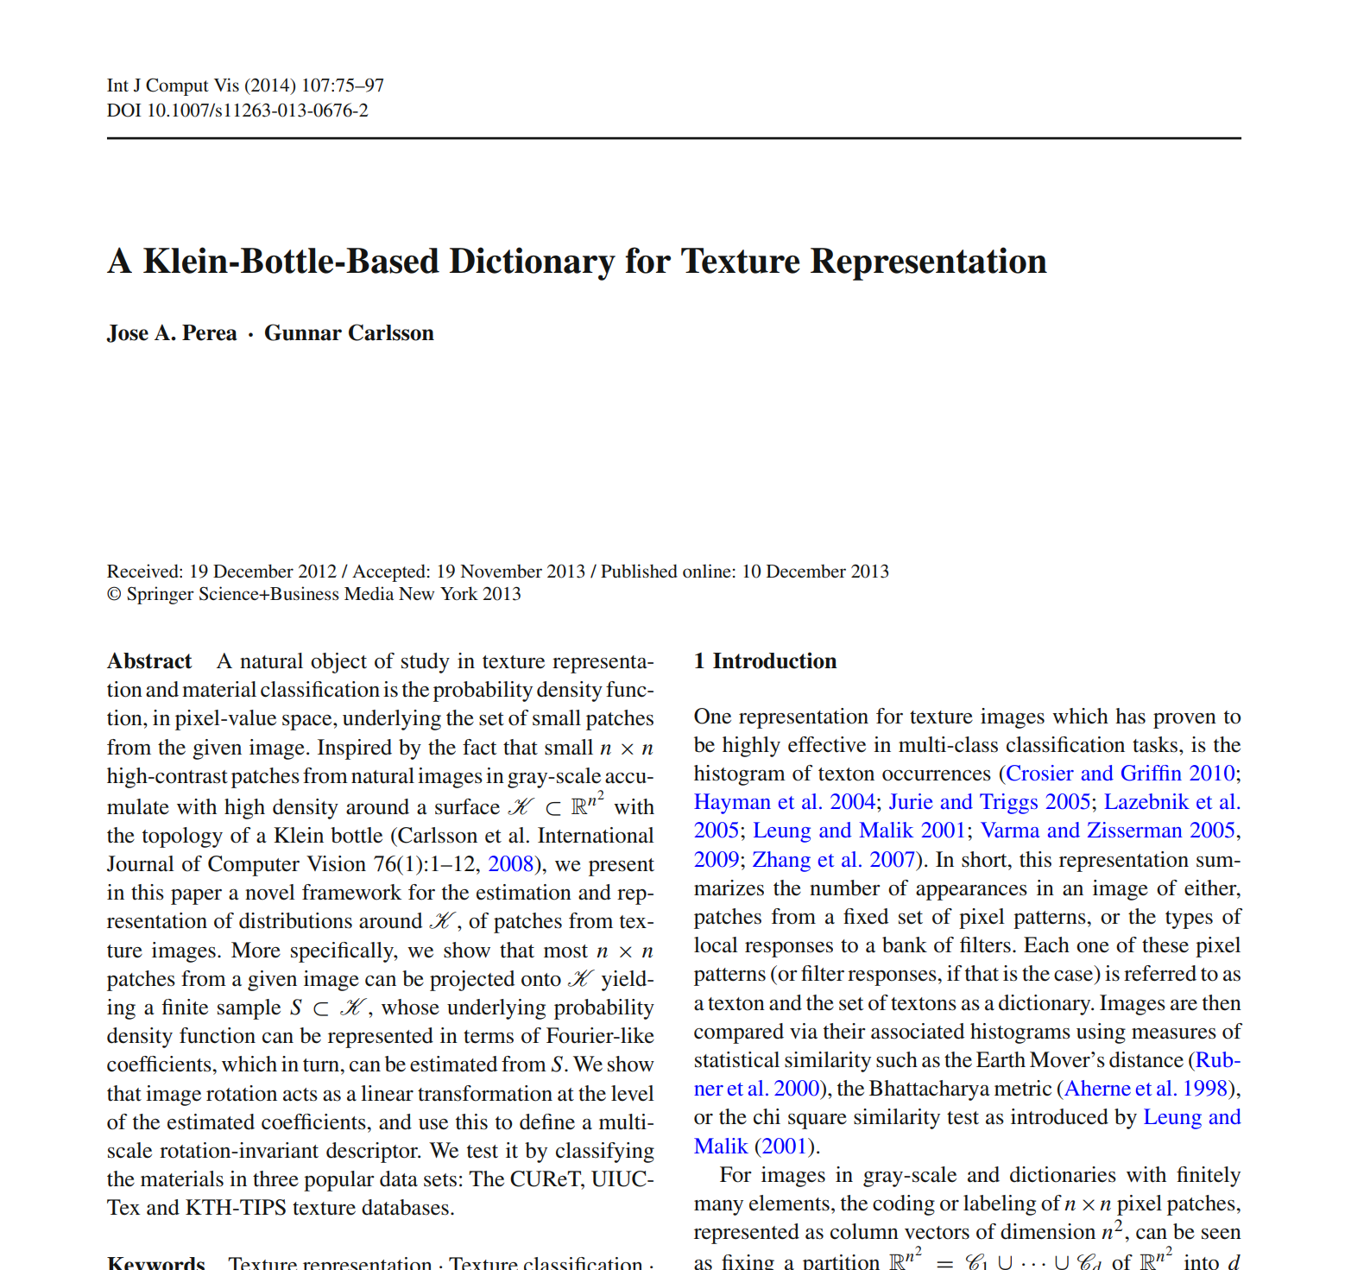
Application: Digital Images
High-contrast 3-by-3 pixel patches from grayscale digital images concentrate near the surface of a Klein bottle in a higher-dimensional space.

Slide 16
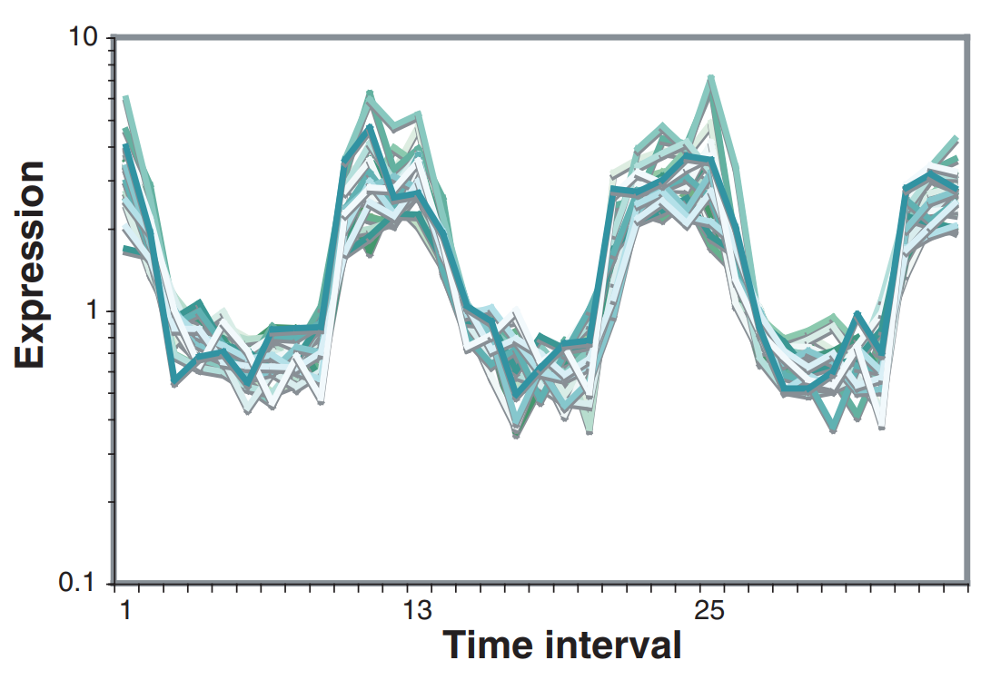
Application: Detecting Periodicity
Persistent homology can detect periodicity in time-series data.
Carlsson and Perea examined biological data:
Gene expression during yeast cell division
Respiratory activity of yeast during metabolic cycles
Circadian rhythm of mice
Image: Tu, Kudlicki, Rowicka, McKnight. “Logic of the Yeast Metabolic Cycle: Temporal Compartmentalization of Cellular Processes.”

Slide 17
Application: Detecting Periodicity
Perea et al. used sliding window embedding to convert a discretized signal to a high-dimensional point cloud.

Slide 18
Application: Detecting Periodicity
Perea et al. used sliding window embedding to convert a discretized signal to a high-dimensional point cloud.
high-dimensional point cloud
persistent homology
signal
Persistent homology can outperform other methods for detecting periodic signals, especially in the presence of damping.

Slide 19

Application: Detecting Periodicity
Persistent homology can detect periodicity in time-series data.
point cloud
persistent homology
signal

Slide 20
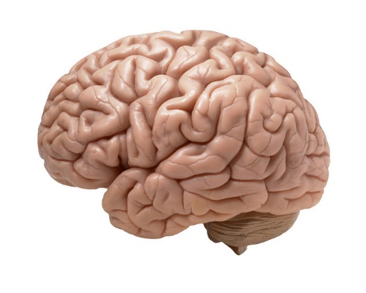
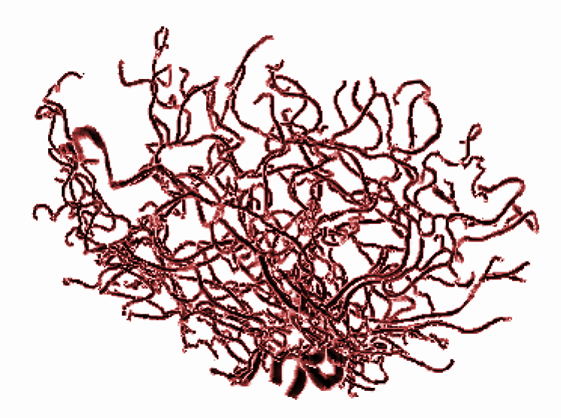
Application: Neuroscience
Data: 98 people had magnetic resonance angiography (MRA) scans of their brains
From each scan was extracted a 3-dimensional tree structure representing the arteries in the brain. Bendich et al. analyzed the trees using persistent homology.

Slide 21
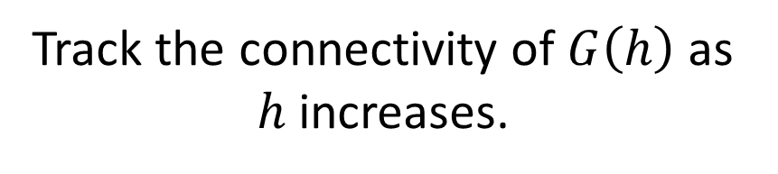
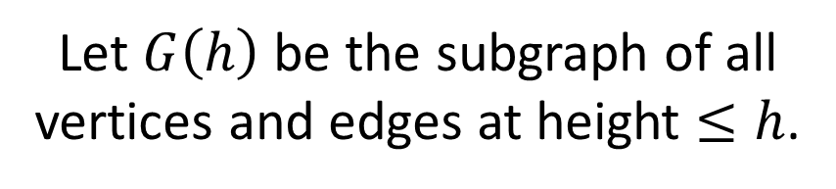

Application: Neuroscience
Sublevel-Set Persistence
Let $G\left(h\right)$ be the subgraph of all vertices and edges at height $≤h$.
Track the connectivity of $G\left(h\right)$ as $h$ increases.
$$H_{0}$$

Slide 22

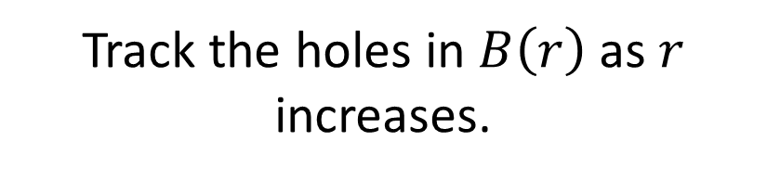

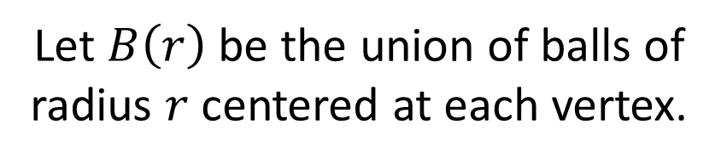




Application: Neuroscience
Thickening Persistence
Let $B\left(r\right)$ be the union of balls of radius $r$ centered at each vertex.
Track the holes in $B\left(r\right)$ as $r$ increases.
$$H_{1}$$
$$0$$
$$1$$
$$2$$
$$3$$
$$4$$

Slide 23
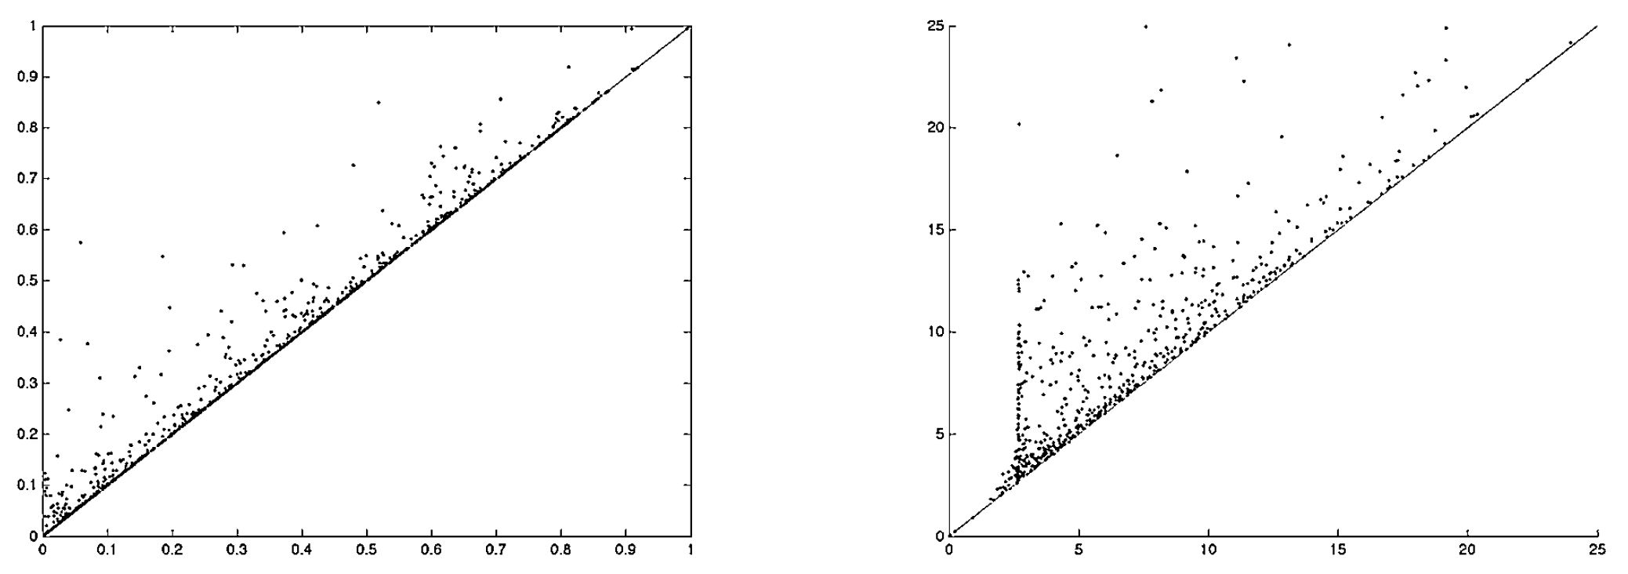
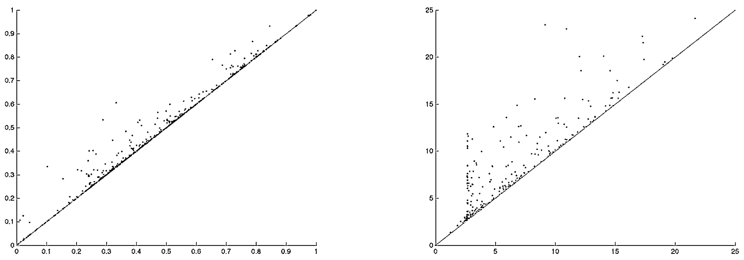




Application: Neuroscience
Persistence diagrams by Bendich et al.
24-year-old brain:
$${Dgm}_{0}$$
$${Dgm}_{1}$$
68-year-old brain:
$${Dgm}_{0}$$
$${Dgm}_{1}$$

Slide 24

Application: Neuroscience
Findings
Persistence features are correlated with age.
$${Dgm}_{0}$$
$${Dgm}_{1}$$
Length of 28th longest bar is most strongly correlated with age.
$${Dgm}_{0}$$
$${Dgm}_{1}$$

Slide 25
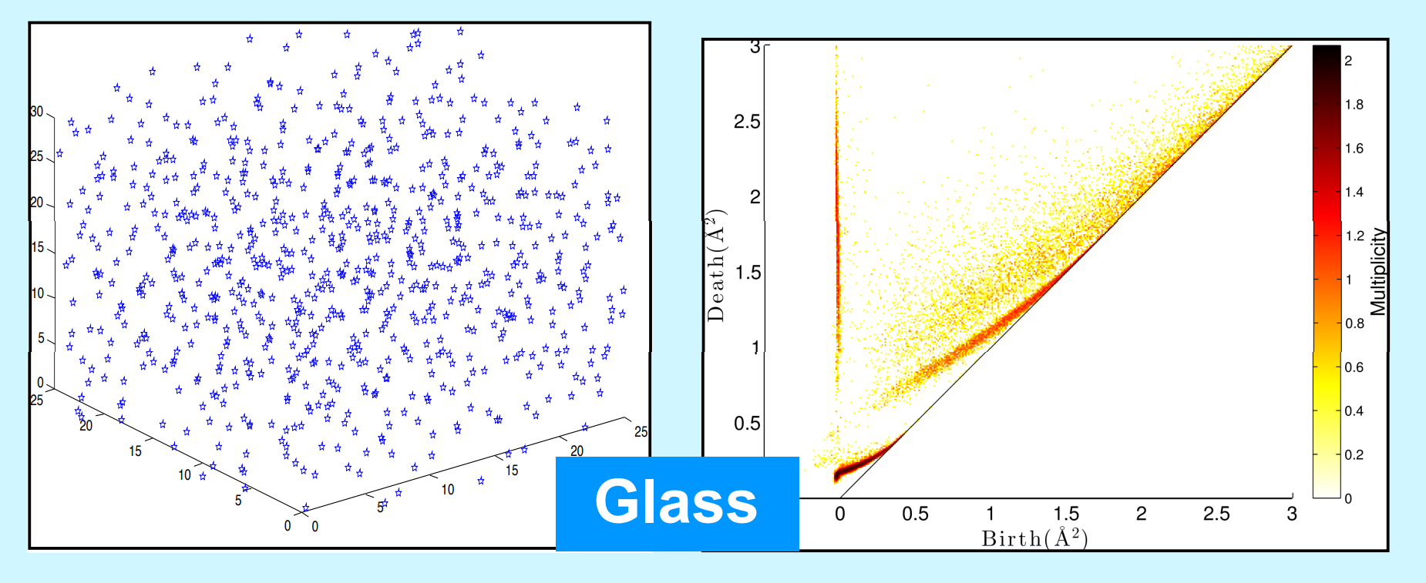
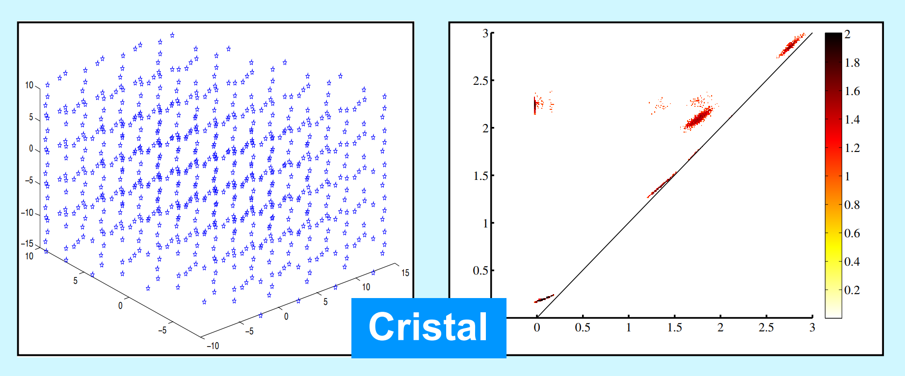
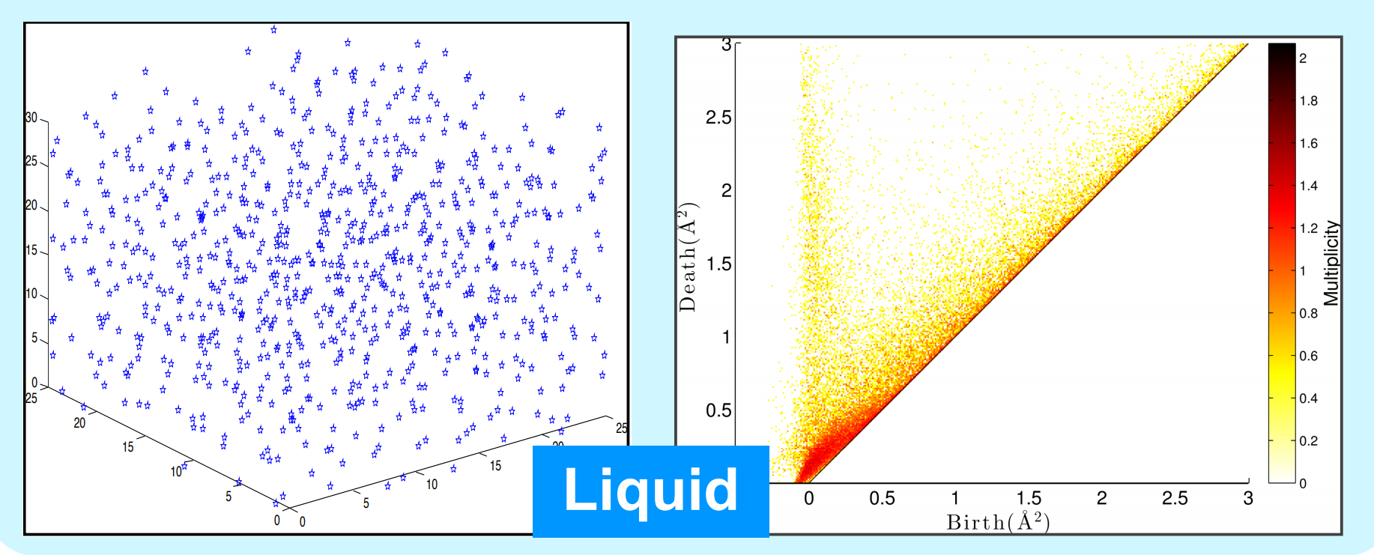
Application: Structure of Materials
Yasu Hiraoka et al. studied the topological structure of atoms in silica glass.
Crystal

Slide 26
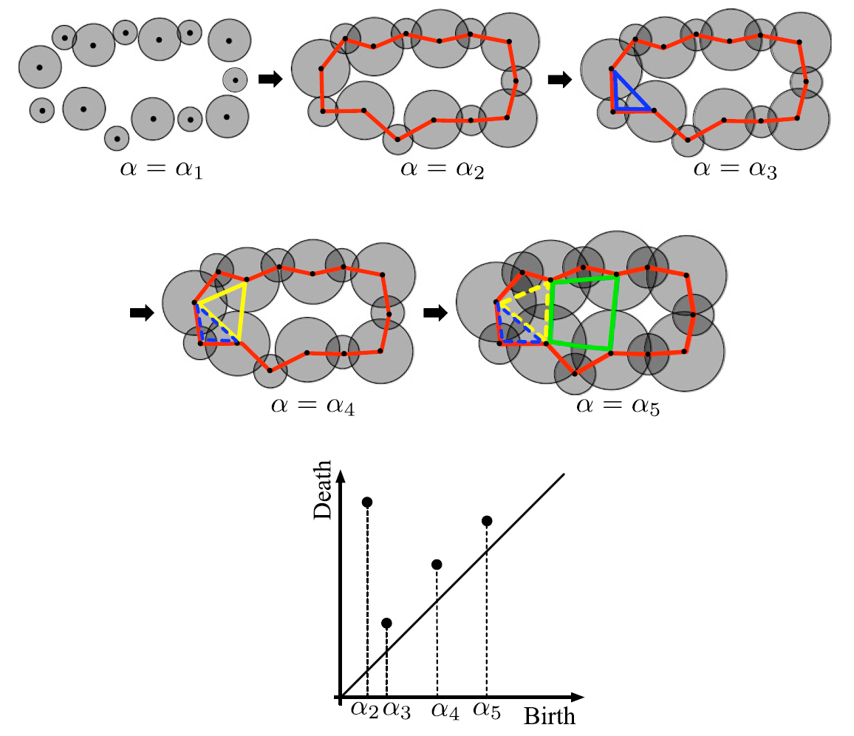
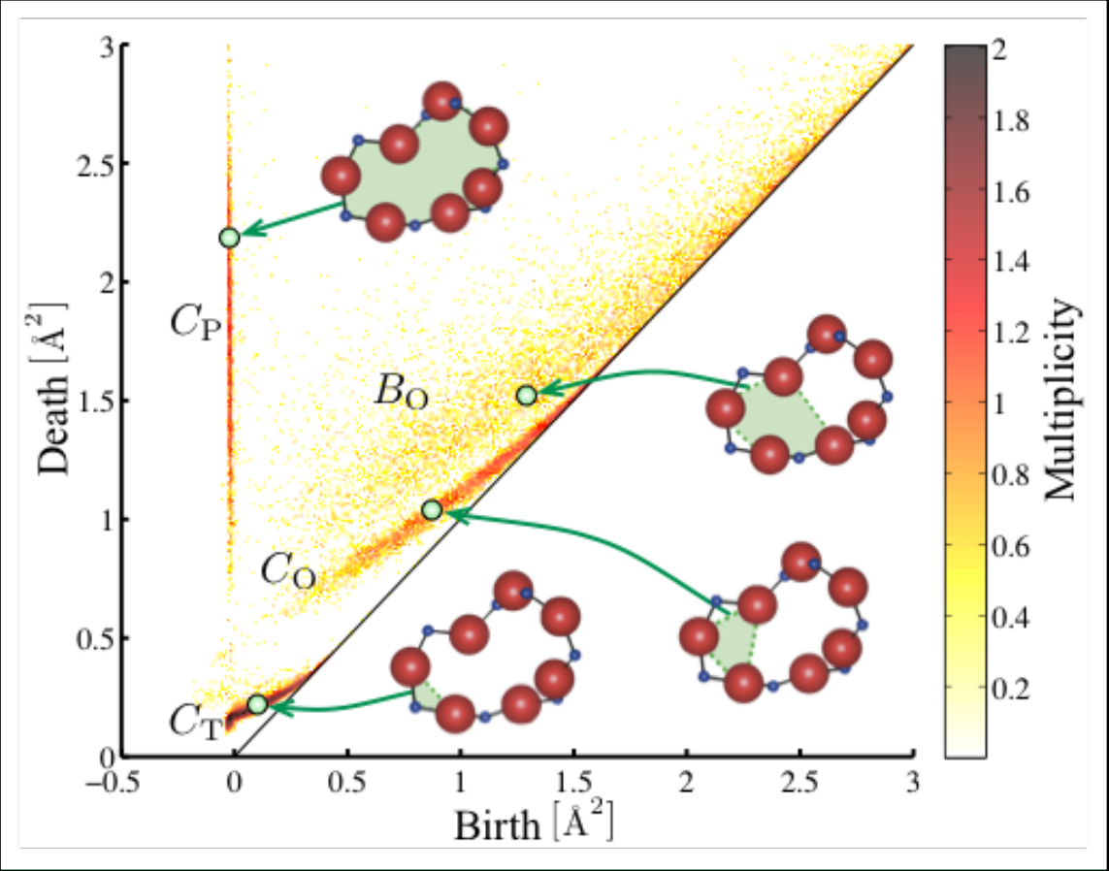
Application: Structure of Materials

Slide 27

Application: Structure of Materials

Slide 28
Stability
Persistence barcodes are stable with respect to perturbations of the data.

Slide 29
Stability
Persistence barcodes are stable with respect to perturbations of the data.

Slide 30
Stability
Persistence barcodes are stable with respect to perturbations of the data.

Slide 31
Stability
Persistence barcodes are stable with respect to perturbations of the data.

Slide 32
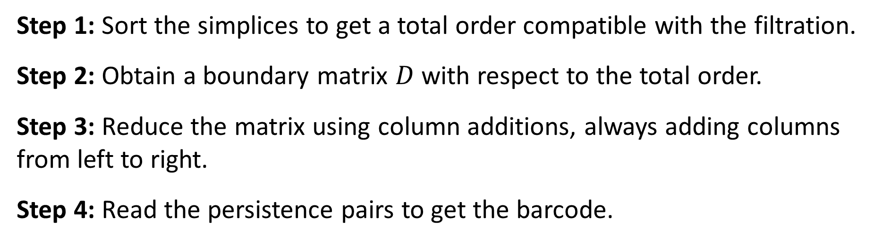

Computing Persistent Homology
Start with a filtered simplicial complex:
$$∅=K_{0}⊂K_{1}⊂⋯⊂K_{m}=K$$
Step 1: Sort the simplices to get a total order compatible with the filtration.
Step 2: Obtain a boundary matrix $D$ with respect to the total order.
Step 3: Reduce the matrix using column additions, always adding columns from left to right.
Step 4: Read the persistence pairs to get the barcode.

Slide 33









Example:
$${∅=K}_{0}$$
$$⊂$$
$$K_{1}$$
$$⊂$$
$$K_{2}$$
$$⊂$$
$$K_{3}$$
$$⊂$$
$$K_{4}=K$$

Slide 34












Example:
$$2$$
$$2$$
$$2$$
$$4$$
$$4$$
$$6$$
$$4$$
$$6$$
$$7$$
$$1$$
$$1$$
$$3$$
$$1$$
$$3$$
$$1$$
$$3$$
$$5$$
$$5$$
$${∅=K}_{0}$$
$$⊂$$
$$K_{1}$$
$$⊂$$
$$K_{2}$$
$$⊂$$
$$K_{3}$$
$$⊂$$
$$K_{4}=K$$
Step 1: Sort the simplices to get a total order compatible with the filtration.
Compatible means:
Simplices in each $K_{i}$ precede simplices in $K−K_{i}$
The faces of each simplex precede the simplex itself

Slide 35






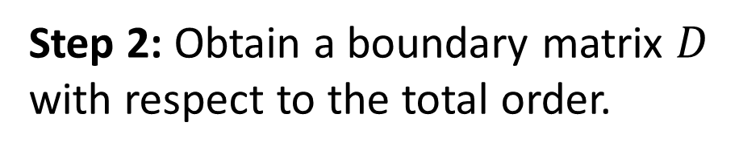



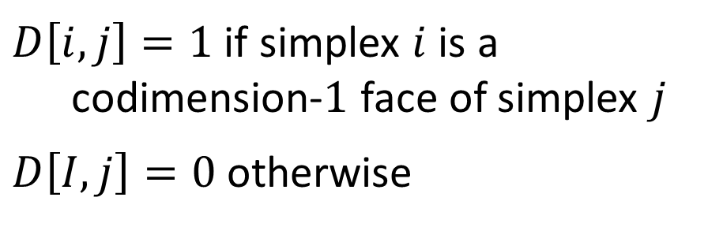









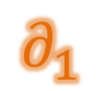

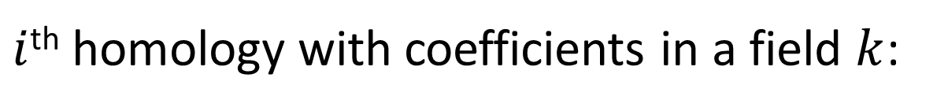
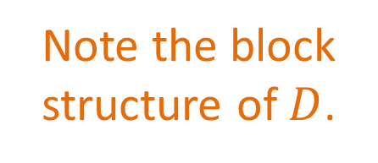


Example:
$$2$$
$$2$$
$$2$$
$$4$$
$$4$$
$$6$$
$$4$$
$$6$$
$$7$$
$$1$$
$$1$$
$$3$$
$$1$$
$$3$$
$$1$$
$$3$$
$$5$$
$$5$$
$${∅=K}_{0}$$
$$⊂$$
$$K_{1}$$
$$⊂$$
$$K_{2}$$
$$⊂$$
$$K_{3}$$
$$⊂$$
$$K_{4}=K$$
Step 2: Obtain a boundary matrix $D$ with respect to the total order.
$$1$$
$$2$$
$$3$$
$$4$$
$$5$$
$$6$$
$$7$$
$$1$$
$$∂_{0}$$
$$1$$
$$1$$
$$2$$
$$1$$
$$∂_{1}$$
$$1$$
$$3$$
$$1$$
$$1$$
$D\left[i,j\right]=1$ if simplex $i$ is a codimension-$1$ face of simplex $j$
$D\left[I,j\right]=0$ otherwise
$$4$$
$$1$$
$$=D$$
$$∂_{2}$$
$$5$$
$$1$$
Note the block structure of $D$.
$$6$$
$$1$$
$$7$$

Slide 36

Example:
$$2$$
$$2$$
$$2$$
$$4$$
$$4$$
$$6$$
$$4$$
$$6$$
$$7$$
$$1$$
$$1$$
$$3$$
$$1$$
$$3$$
$$1$$
$$3$$
$$5$$
$$5$$
$${∅=K}_{0}$$
$$⊂$$
$$K_{1}$$
$$⊂$$
$$K_{2}$$
$$⊂$$
$$K_{3}$$
$$⊂$$
$$K_{4}=K$$
Step 2: Obtain a boundary matrix $D$ with respect to the total order.
$$1$$
$$2$$
$$3$$
$$4$$
$$5$$
$$6$$
$$7$$
$$1$$
$$1$$
$$1$$
$$2$$
$$1$$
$$1$$
Define $low(j)$ to be the row number of the lowest non-zero entry in column $j$. If column $j$ is empty, then $low\left(j\right)=0$.
$$3$$
$$1$$
$$1$$
$$4$$
$$1$$
$$=D$$
$$5$$
$$1$$
$$6$$
$$1$$
Example: $low\left(2\right)=0$ and $low\left(5\right)=3$
$$7$$

Slide 37


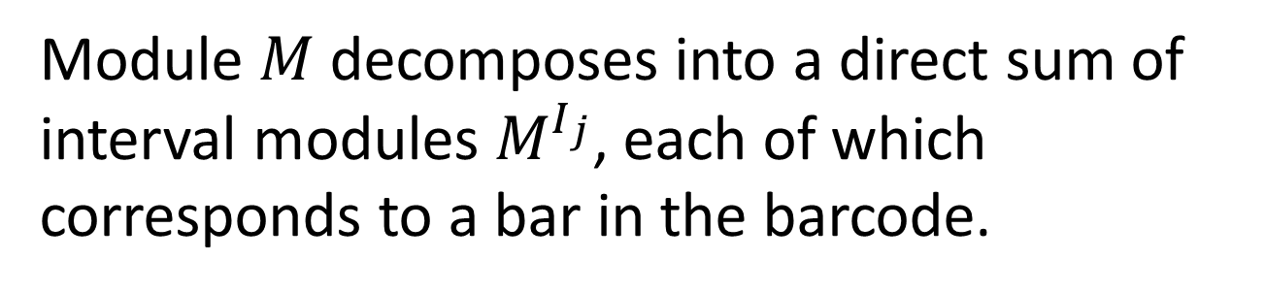












Example:
$$2$$
$$2$$
$$2$$
$$4$$
$$4$$
$$6$$
$$4$$
$$6$$
$$7$$
$$1$$
$$1$$
$$3$$
$$1$$
$$3$$
$$1$$
$$3$$
$$5$$
$$5$$
$${∅=K}_{0}$$
$$⊂$$
$$K_{1}$$
$$⊂$$
$$K_{2}$$
$$⊂$$
$$K_{3}$$
$$⊂$$
$$K_{4}=K$$
Step 3: Reduce the matrix.
$$1$$
$$2$$
$$3$$
$$4$$
$$5$$
$$6$$
$$7$$
$$1$$
$$1$$
$$0$$
$$1$$
$$1$$
$$1$$
$$2$$
$$1$$
$$0$$
ALGORITHM
$$1$$
$$1$$
$$3$$
$$0$$
for j = 1 to n:
while ∃ j' < j with low(j') = low(j) ≠ 0:
add column j' to column j
$$4$$
$$1$$
$$5$$
$$1$$
$$6$$
$$1$$
$$7$$

Slide 38
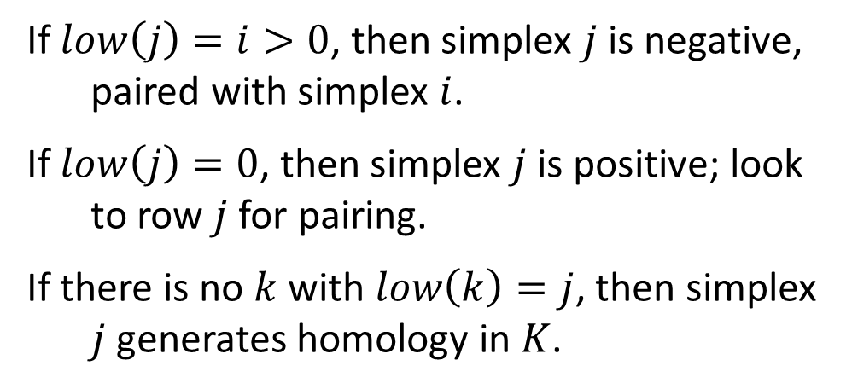
Example:
$$2$$
$$2$$
$$2$$
$$4$$
$$4$$
$$6$$
$$4$$
$$6$$
$$7$$
$$1$$
$$1$$
$$3$$
$$1$$
$$3$$
$$1$$
$$3$$
$$5$$
$$5$$
$${∅=K}_{0}$$
$$⊂$$
$$K_{1}$$
$$⊂$$
$$K_{2}$$
$$⊂$$
$$K_{3}$$
$$⊂$$
$$K_{4}=K$$
Step 4: Read the persistence pairs.
$$1$$
$$2$$
$$3$$
$$4$$
$$5$$
$$6$$
$$7$$
$$1$$
$$1$$
$$1$$
If $low\left(j\right)=i>0$, then simplex $j$ is negative, paired with simplex $i$.
If $low\left(j\right)=0$, then simplex $j$ is positive; look to row $j$ for pairing.
If there is no $k$ with $low\left(k\right)=j$, then simplex $j$ generates homology in $K$.
$$2$$
$$1$$
$$3$$
$$1$$
$$4$$
$$1$$
$$5$$
$$1$$
$$6$$
$$1$$
$$7$$

Slide 39
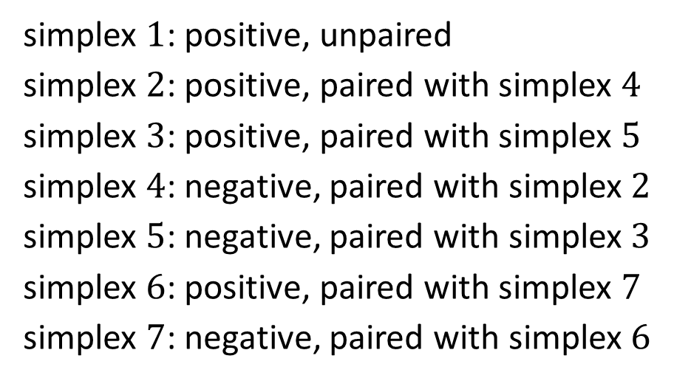
Example:
$$2$$
$$2$$
$$2$$
$$4$$
$$4$$
$$6$$
$$4$$
$$6$$
$$7$$
$$1$$
$$1$$
$$3$$
$$1$$
$$3$$
$$1$$
$$3$$
$$5$$
$$5$$
$${∅=K}_{0}$$
$$⊂$$
$$K_{1}$$
$$⊂$$
$$K_{2}$$
$$⊂$$
$$K_{3}$$
$$⊂$$
$$K_{4}=K$$
simplex $1$: positive, unpaired
simplex $2$: positive, paired with simplex $4$
simplex $3$: positive, paired with simplex $5$
simplex $4$: negative, paired with simplex $2$
simplex $5$: negative, paired with simplex $3$
simplex $6$: positive, paired with simplex $7$
simplex $7$: negative, paired with simplex $6$
$$1$$
$$2$$
$$3$$
$$4$$
$$5$$
$$6$$
$$7$$
$$1$$
$$1$$
$$1$$
$$2$$
$$1$$
$$3$$
$$1$$
$$4$$
$$1$$
$$5$$
$$1$$
$$6$$
$$1$$
$$7$$

Slide 40



Example:
$$2$$
$$2$$
$$2$$
$$4$$
$$4$$
$$6$$
$$4$$
$$6$$
$$7$$
$$1$$
$$1$$
$$3$$
$$1$$
$$3$$
$$1$$
$$3$$
$$5$$
$$5$$
$${∅=K}_{0}$$
$$⊂$$
$$K_{1}$$
$$⊂$$
$$K_{2}$$
$$⊂$$
$$K_{3}$$
$$⊂$$
$$K_{4}=K$$
simplex $1$: positive, unpaired
simplex $2$: positive, paired with simplex $4$
simplex $3$: positive, paired with simplex $5$
simplex $4$: negative, paired with simplex $2$
simplex $5$: negative, paired with simplex $3$
simplex $6$: positive, paired with simplex $7$
simplex $7$: negative, paired with simplex $6$
bar $\left[1, ∞\right)$ in $H_{0}$ homology
simplices 2 and 4 enter at the same time, so the pair does not produce a bar
bar $\left[2,3\right)$ in $H_{0}$ homology
bar $\left[3,4\right)$ in $H_{1}$ homology

Slide 41






Example:
$$2$$
$$2$$
$$2$$
$$4$$
$$4$$
$$6$$
$$4$$
$$6$$
$$7$$
$$1$$
$$1$$
$$3$$
$$1$$
$$3$$
$$1$$
$$3$$
$$5$$
$$5$$
$${∅=K}_{0}$$
$$⊂$$
$$K_{1}$$
$$⊂$$
$$K_{2}$$
$$⊂$$
$$K_{3}$$
$$⊂$$
$$K_{4}=K$$
Now we can draw the barcode:
bar $\left[1, ∞\right)$ in $H_{0}$ homology
$$H_{1}$$
simplices 2 and 4 enter at the same time, so the pair does not produce a bar
$$H_{0}$$
bar $\left[2,3\right)$ in $H_{0}$ homology
bar $\left[3,4\right)$ in $H_{1}$ homology
$$1$$
$$2$$
$$3$$
$$4$$

Slide 42
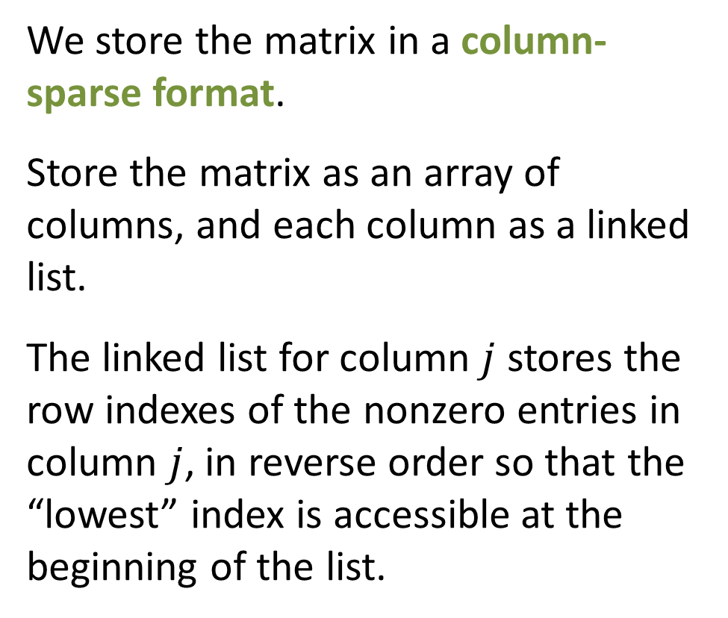
Data Structures
1
2
3
4
5
6
7
We store the matrix in a column-sparse format.
Store the matrix as an array of columns, and each column as a linked list.
The linked list for column $j$ stores the row indexes of the nonzero entries in column $j$, in reverse order so that the “lowest” index is accessible at the beginning of the list.
2
3
3
6
1
1
2
5
4

Slide 43
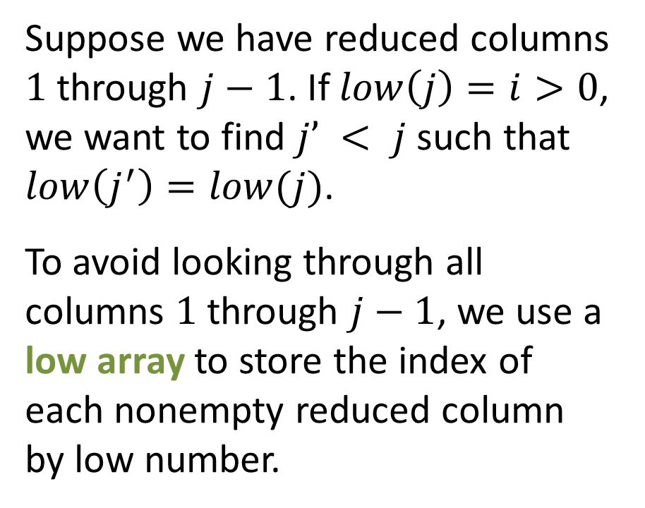
Data Structures
Suppose we have reduced columns $1$ through $j−1$. If $low\left(j\right)=i>0$, we want to find $j’ < j$ such that $low\left(j^{′}\right)=low(j)$.
To avoid looking through all columns $1$ through $j−1$, we use a low array to store the index of each nonempty reduced column by low number.
low array
1
2
3
4
5
6
7
1
2
4
2
3
3
6
3
5
1
1
2
5
4
5
4
6
7

Slide 44
Data Structures
Suppose we have reduced columns $1$ through $j−1$. If $low\left(j\right)=i>0$, we want to find $j’ < j$ such that $low\left(j^{′}\right)=low(j)$.
To avoid looking through all columns $1$ through $j−1$, we use a low array to store the index of each nonempty reduced column by low number.
low array
1
2
3
4
5
6
7
1
2
4
2
3
2
6
3
5
1
1
1
5
4
5
4
6
7

Slide 45
Data Structures
Suppose we have reduced columns $1$ through $j−1$. If $low\left(j\right)=i>0$, we want to find $j’ < j$ such that $low\left(j^{′}\right)=low(j)$.
To avoid looking through all columns $1$ through $j−1$, we use a low array to store the index of each nonempty reduced column by low number.
low array
1
2
3
4
5
6
7
1
2
4
2
3
6
3
5
1
1
5
4
5
4
6
7
7

Slide 46








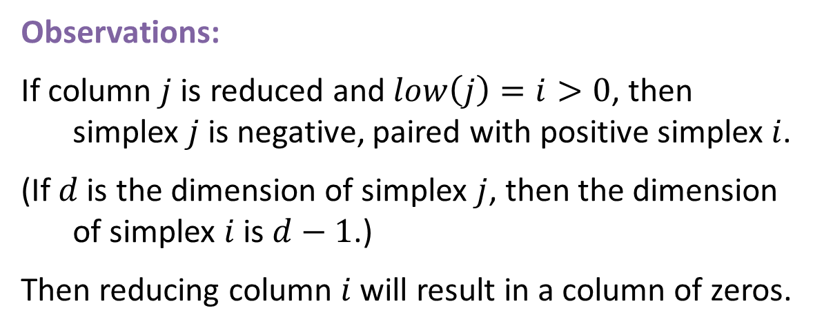






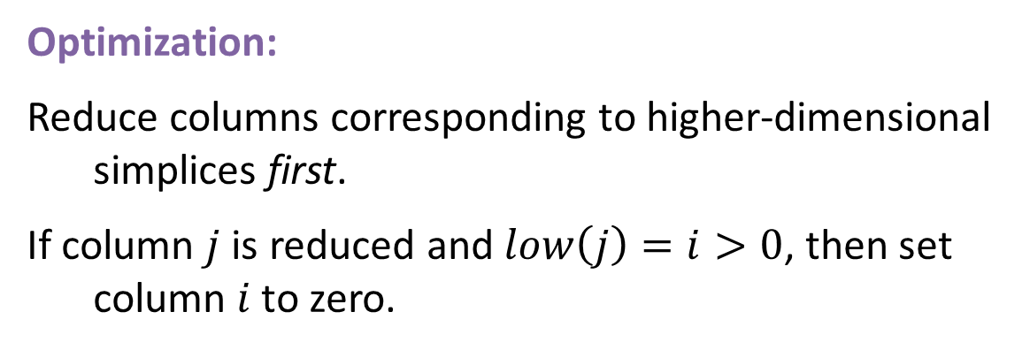






“Twist” Optimization
Observations:
If column $j$ is reduced and $low\left(j\right)=i>0$, then simplex $j$ is negative, paired with positive simplex $i$.
(If $d$ is the dimension of simplex $j$, then the dimension of simplex $i$ is $d−1$.)
Then reducing column $i$ will result in a column of zeros.
reduced matrix
$$1$$
$$2$$
$$3$$
$$4$$
$$5$$
$$6$$
$$7$$
$$1$$
$$1$$
$$1$$
$$2$$
$$1$$
$$3$$
$$1$$
$$4$$
$$1$$
$$5$$
$$1$$
Optimization:
Reduce columns corresponding to higher-dimensional simplices first.
If column $j$ is reduced and $low\left(j\right)=i>0$, then set column $i$ to zero.
$$6$$
$$1$$
$$7$$

Slide 47








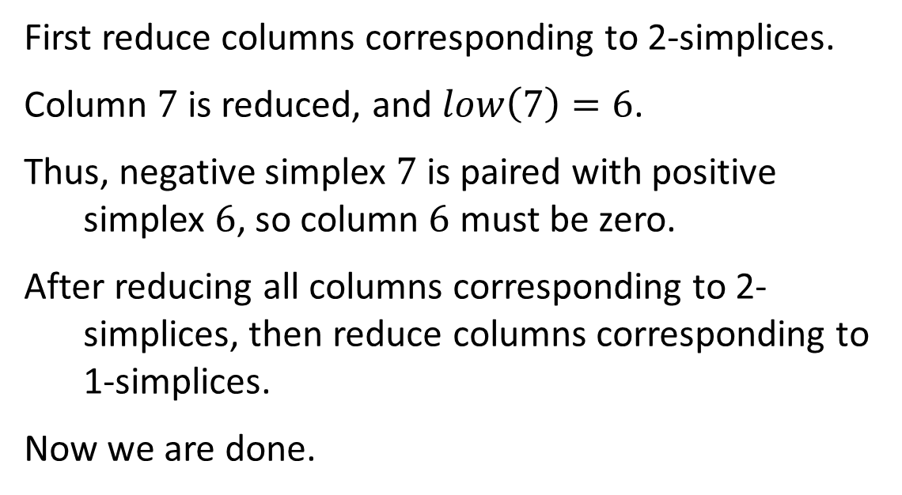















“Twist” Optimization
Example: same boundary matrix as before
unreduced matrix
First reduce columns corresponding to 2-simplices.
Column $7$ is reduced, and $low\left(7\right)=6$.
Thus, negative simplex $7$ is paired with positive simplex $6$, so column $6$ must be zero.
After reducing all columns corresponding to 2-simplices, then reduce columns corresponding to 1-simplices.
Now we are done.
$$1$$
$$2$$
$$3$$
$$4$$
$$5$$
$$6$$
$$7$$
$$1$$
$$1$$
$$1$$
$$2$$
$$1$$
$$1$$
$$3$$
$$1$$
$$1$$
$$4$$
$$1$$
$$5$$
$$1$$
$$6$$
$$1$$
$$7$$

Slide 48
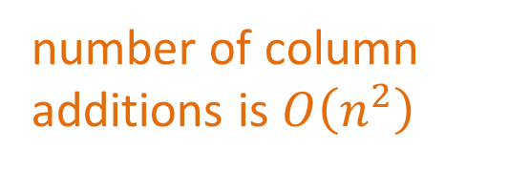
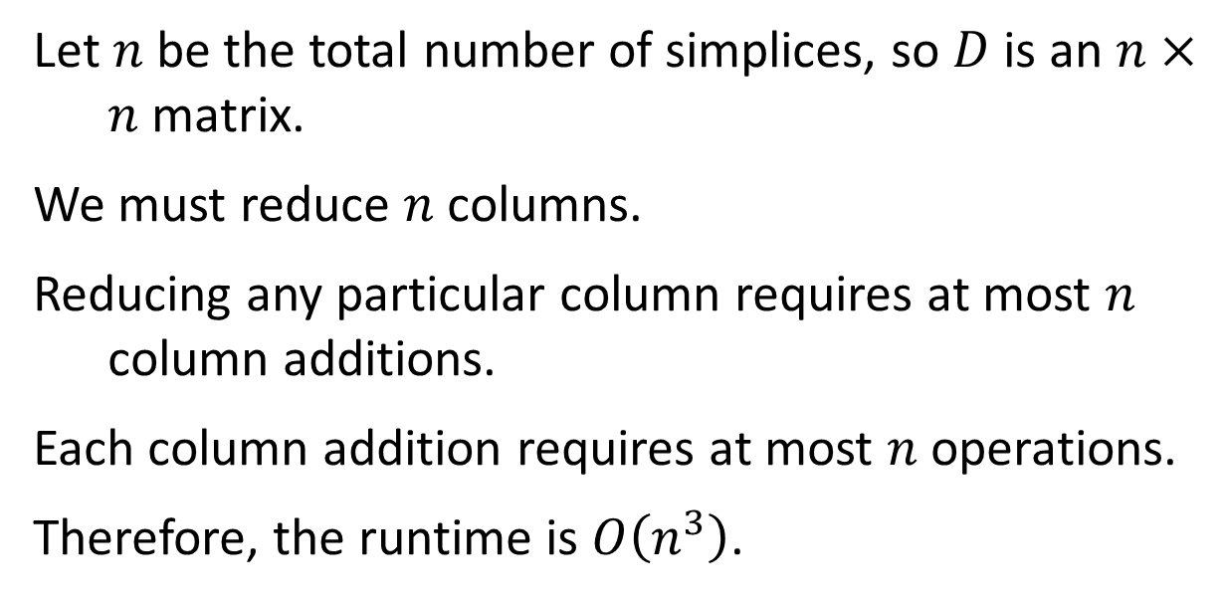
Runtime Complexity
Let $n$ be the total number of simplices, so $D$ is an $n×n$ matrix.
We must reduce $n$ columns.
Reducing any particular column requires at most $n$ column additions.
Each column addition requires at most $n$ operations.
Therefore, the runtime is $O\left(n^{3}\right)$.
number of column additions is $O\left(n^{2}\right)$
However, in practice, the runtime is usually better than cubic.
Note that this complexity is just for the matrix reduction, and doesn’t include building the filtration or boundary matrix.

Slide 49


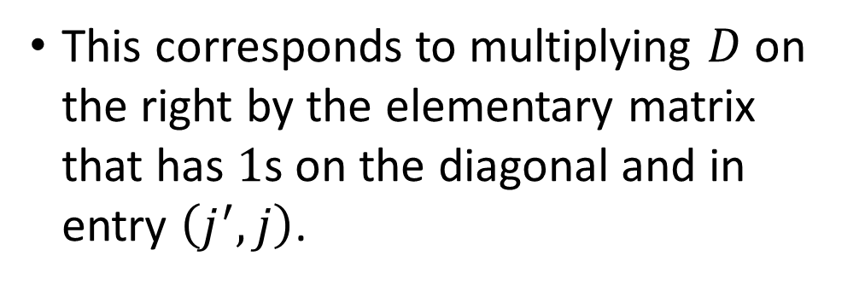


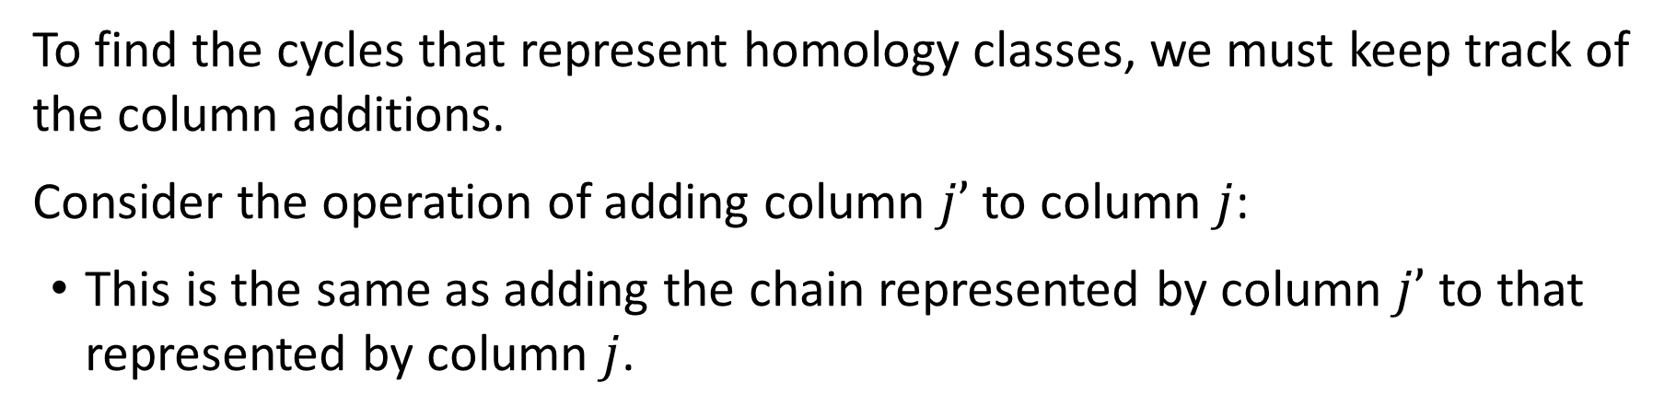






Generating Cycles
To find the cycles that represent homology classes, we must keep track of the column additions.
Consider the operation of adding column $j’$ to column $j$:
This is the same as adding the chain represented by column $j’$ to that represented by column $j$.
$$j$$
This corresponds to multiplying $D$ on the right by the elementary matrix that has $1$s on the diagonal and in entry $\left(j^{′}, j\right)$.
$$1$$
$$1$$
$$1$$
$$1$$
$$j′$$
$$D$$
$$1$$
…
$$1$$
$$1$$

Slide 50

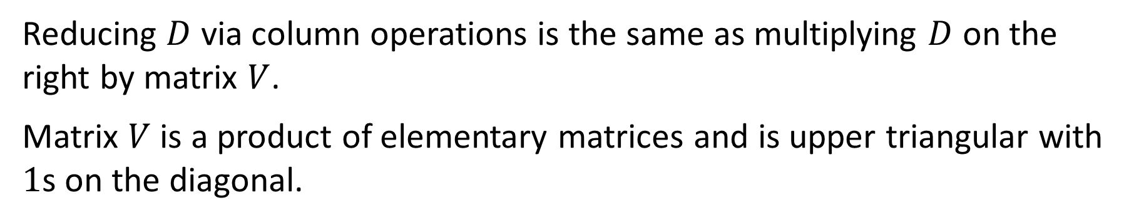



Generating Cycles
Reducing $D$ via column operations is the same as multiplying $D$ on the right by matrix $V$.
Matrix $V$ is a product of elementary matrices and is upper triangular with $1$s on the diagonal.
$$R$$
$$=$$
$$D$$
$$V$$

Slide 51




Generating Cycles
The columns of $V$ indicate the cycles and chains that kill cycles.
If column $j$ in $R$ is empty, then column $j$ in $V$ gives the corresponding cycle.
Otherwise, column $j$ in $V$ gives the chain that kills the cycle corresponding to $low(j)$.
$$=$$
$$R$$
$$D$$
$$V$$

Slide 52


